Slide 1
Data Quality Monitoring and Data Movement with Azure Services
Abhishek Kanoujia
Data Engineering Batch-1

Slide 2
Introduction
Recognizing the critical importance of data quality, this project focuses on implementing robust data quality assessment techniques and efficient data transfer mechanisms using modern cloud-based technologies.

Slide 3
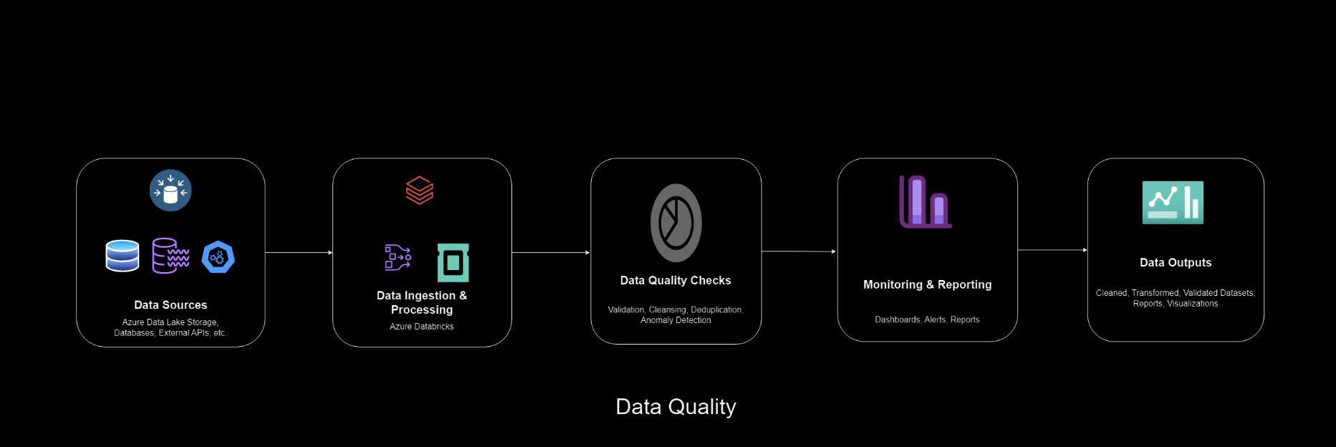
Architecture Diagram

Slide 4
Project Scope
The scope of the project encompasses the following key areas:
Definition and implementation of data quality assessment processes using Databricks and Pandas, including data filtering, validation, and handling of invalid data.
Configuration and deployment of data transfer pipelines utilizing Azure Data Factory for transferring data between Azure Data Lake Storage (ADLS) instances.
Evaluation of the effectiveness and efficiency of the implemented solutions in ensuring data quality and facilitating seamless data transfer operations.

Slide 5
Project Components
1. Data Sources
2. Data Ingestion & Processing (Azure Databricks)
3. Data Quality Checks
4. Monitoring & Reporting
5. Data Outputs

Slide 6
Technologies Used
Azure Data Factory (ADF)
Azure Data Lake Storage Gen2
Azure Databricks

Slide 7
Implementation
1. Null Counts for Each Column
2. Duplicate Count
3. Data Types
4. Filtering Data
5. Column Profiling
6. Missing Values
7. Summary Statistics

Slide 8
Conclusion
The data quality assessment conducted using the above checks provides valuable insights into the quality, completeness, and integrity of the dataset.
By identifying missing values, duplicates, and inconsistencies, potential data quality issues were uncovered, paving the way for data cleansing and improvement efforts.
The findings from the data quality assessment serve as a foundation for ensuring data reliability and trustworthiness, ultimately enhancing the validity and utility of downstream data analysis and decision-making processes.
The configuration and implementation of data transfer pipelines using Azure Data Factory enable organizations to efficiently move data between Azure Data Lake Storage instances while maintaining data integrity, reliability, and security. By leveraging Azure Data Factory's intuitive interface and robust features, data engineers can orchestrate complex data movement tasks with ease, facilitating seamless data integration and interoperability across disparate data sources and destinations.

Slide 9
Queries

